Slide 1
Raspberry Pi overview
week1

Slide 2
Computer
Every computer provides a way to enter information.
We think of a keyboard and a mouse.
But it can also be Wi-Fi, and ethernet and serial ports, or specialized electronics.
The raspberry pi has all of these methods on the circuit board. And especially provides a set of pins for input of electronic signals.

Slide 3
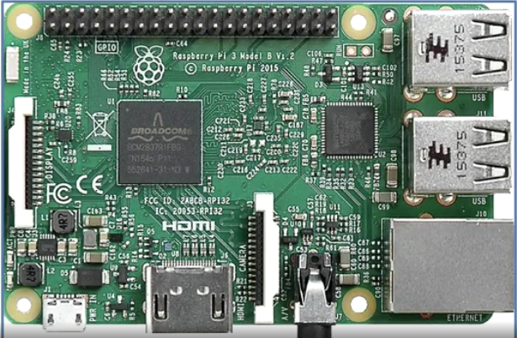

Slide 4
Memory
Computers use memory to remember things.
This can be internal, such as random access memory or RAM.
Or read-only memory or ROM.
Computers have external mass storage such as a hard drive or cloud storage.
The raspberry pie has memory as well.
It uses an onboard memory chip and an SD card for external storage.
The raspberry pie can also use USB flash drives for external storage.

Slide 5
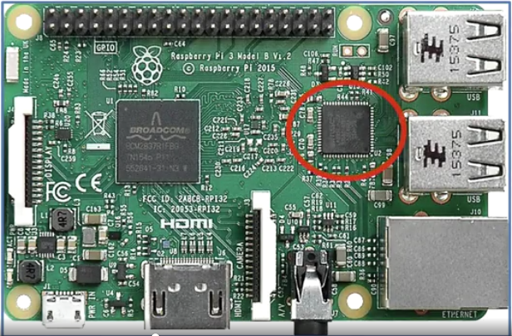
<= Input for electronic signals
<= Input for electronic signals
<= onboard memory chip

Slide 6
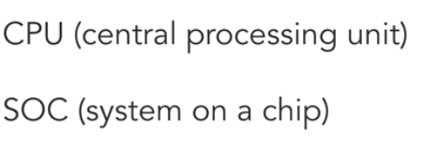
Where is CPU on a raspberry pie?
On a raspberry pie, there is a CPU and a Broadcom SOC.
Raspberry pie can also perform calculations.

Slide 7
